Slide 1
Capstone Project
Ted talk view prediction
By-
PUSHKAR SRIVASTAVA
RAHUL PANDEY
HRITIK SHARMA

Slide 2
Point of discussion
Introduction
Problem statement
Variables for daily views
Bivariate analysis with dependent variable
Target Encoding
Feature Engineering and Data preprocessing
Outliers Detection
Removing collinearity
Variance inflation factor analysis
Let’s Check Normality in data
Model Preparation

Slide 3
Point of discussion
Error metrics
Running grid search cross validation for lasso regression
Running grid search cross validation for ridge regression
Running grid search cross validation for elastic regression
Conclusion

Slide 4
INTRODUCTION
TED talk is a nonprofit organisation that aimed at bringing experts from the fields of Technology, Entertainment, and Design together.TED talks have been given for many years with the platform of "Ideas Worth Spreading". In the digital world we live in today, TED is a great platform to get your idea out there. But how do you know if your idea will be heard or appreciated? We aim to perform a comprehensive analysis of TED talks to determine what it is that makes an idea powerful.
These datasets contain over 4,000 TED talks including transcripts in many languages

Slide 5
PROBLEM STATEMENT
The main objective is to build a predictive model, which could help in predicting the views of the videos uploaded on the TEDx website.

Slide 6
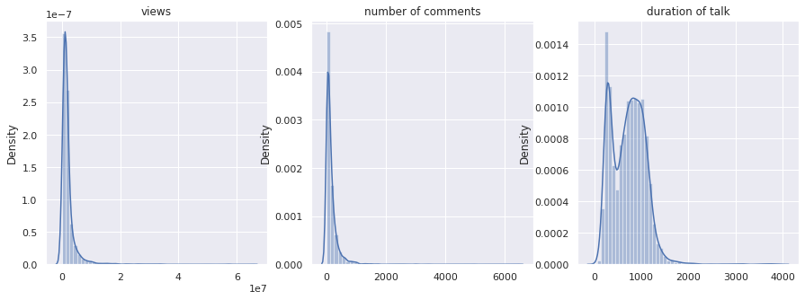
Exploratory Data Analysis
Univariate analysis
Univariate analysis is the simplest form of analyzing data.

Slide 7
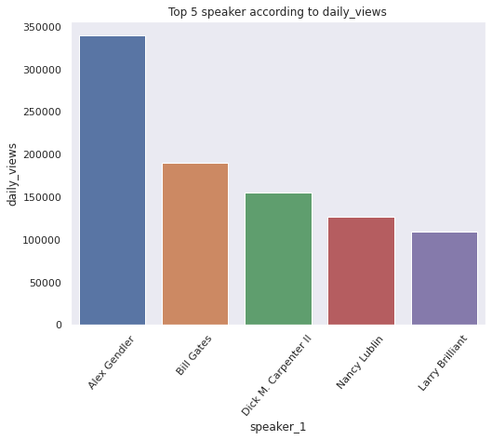
Bivariate analysis with dependent variable
speaker_1 vs daily_views
Ted Talk by Alex Gendler has the highest daily views followed by Bill Gates.
Here it seems the daily views does depend on the first speaker.

Slide 8
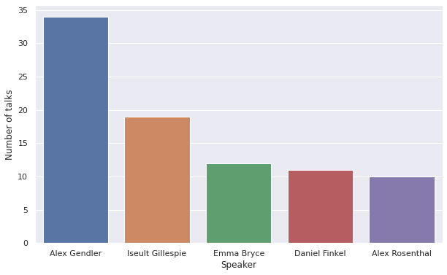
Speaker Vs Number of talks delivered
Alex Gendler also has highest number of talks that could explain such high overall views.

Slide 9
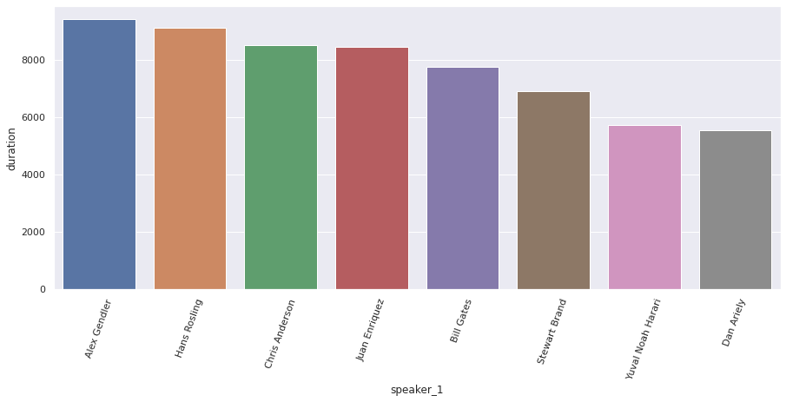
speaker vs duration

Slide 10
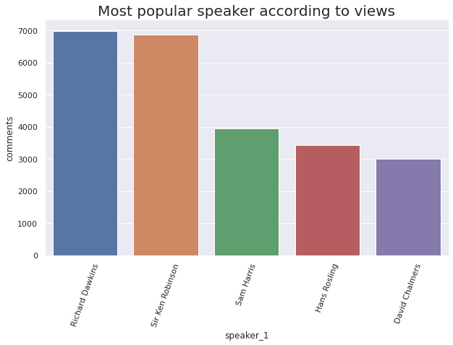
Speaker vs comments
Richard Dawkins has highest number of comments followed by Sir Ken Robinson

Slide 11
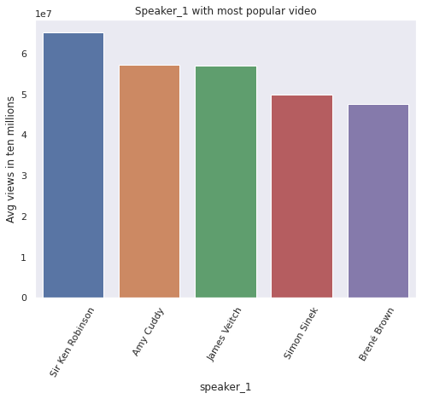
Speaker vs Average Views

Slide 12
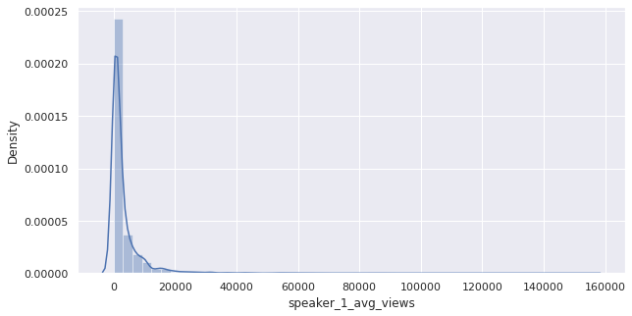
Target Encoding
Target encoding is the process of replacing a categorical variable values with the mean of the target (dependent variable) variable
Applying Target encoding on speaker_1

Slide 13
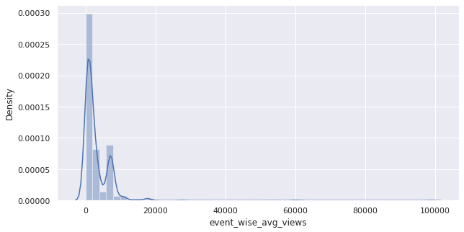
Event
Event is also a categorical variable, therefore we also apply target encoding on it

Slide 14
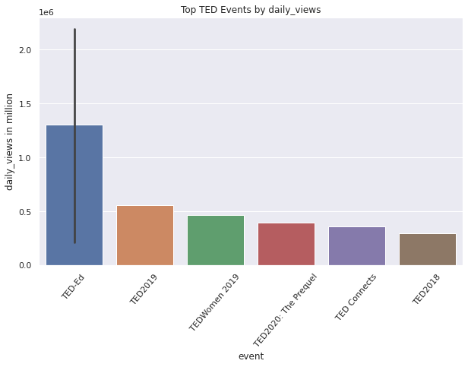
Top ted talk event

Slide 15
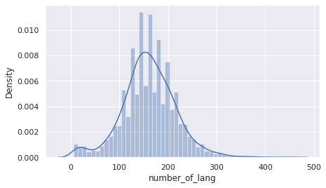
available_language variable

Slide 16
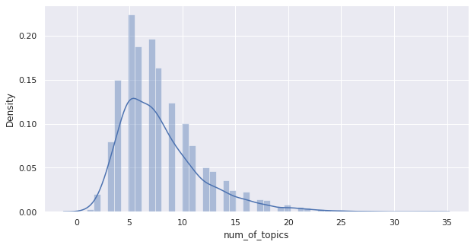
num_of_topic variable from topic variable

Slide 17
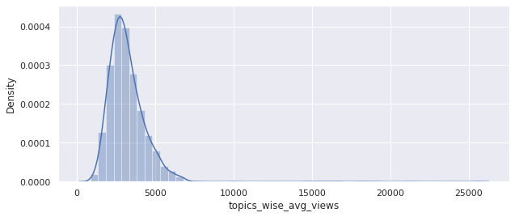
Target coding on unique topics

Slide 18
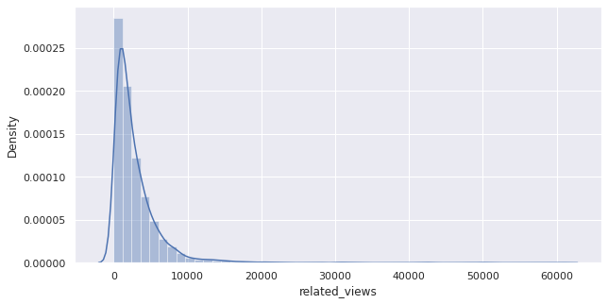
Related talk variable

Slide 19
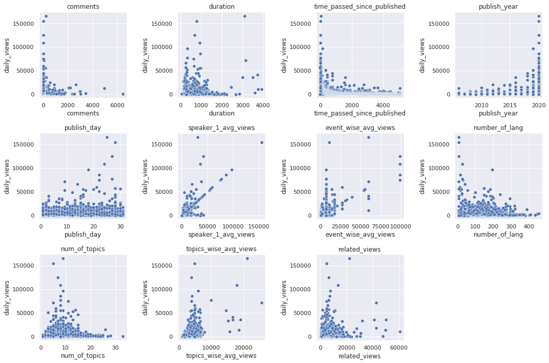
Feature Engineering and Data Preprocessing
Verifying OLS assumptions Linearity

Slide 20
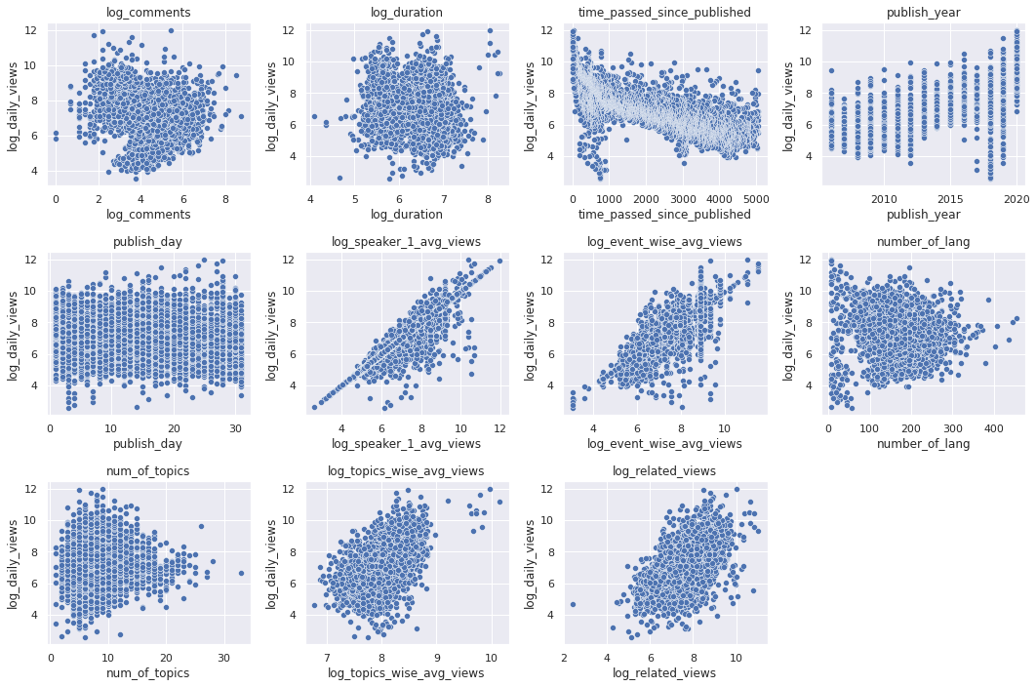
Transformation for Linearity

Slide 21
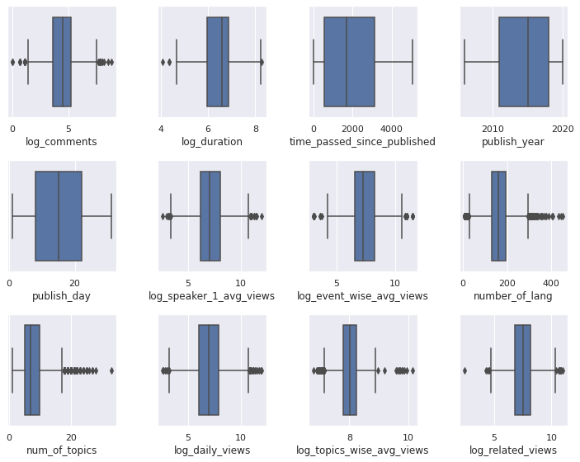
Outliers Detection (Before)

Slide 22
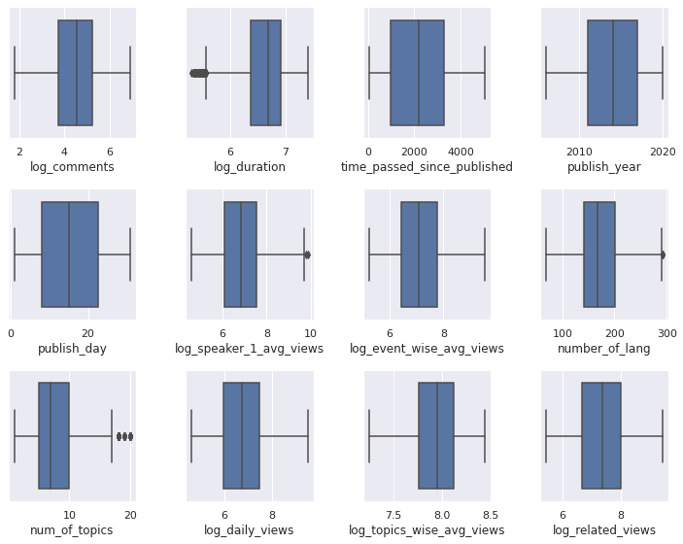
Outliers Detection (After)

Slide 23
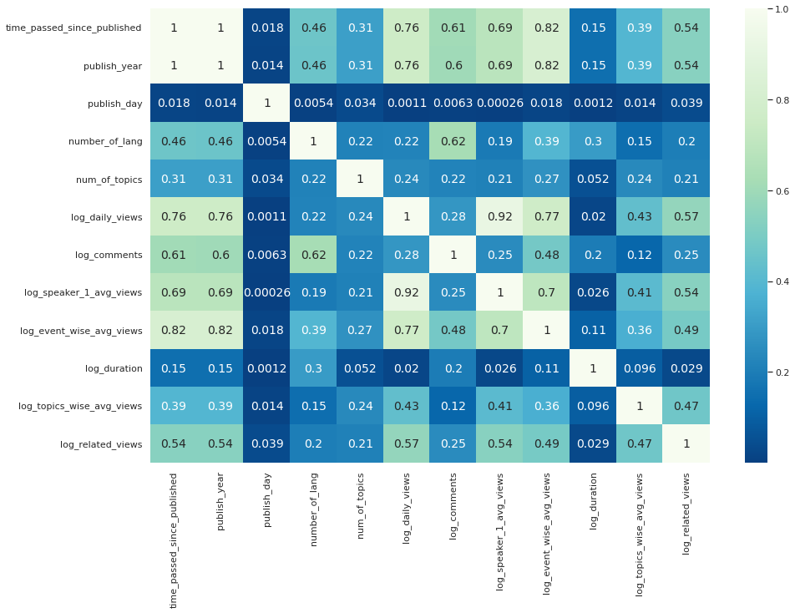
Removing collinearity
After removing collinearity from the features we were left with features:
time_passed_since_published
publish_day
num_of_topics
log_speaker_1_avg_views

Slide 24
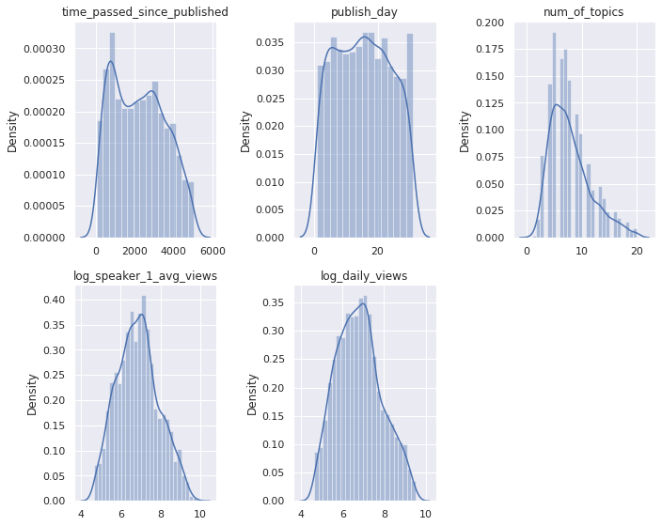
Normal distribution of features in data

Slide 25
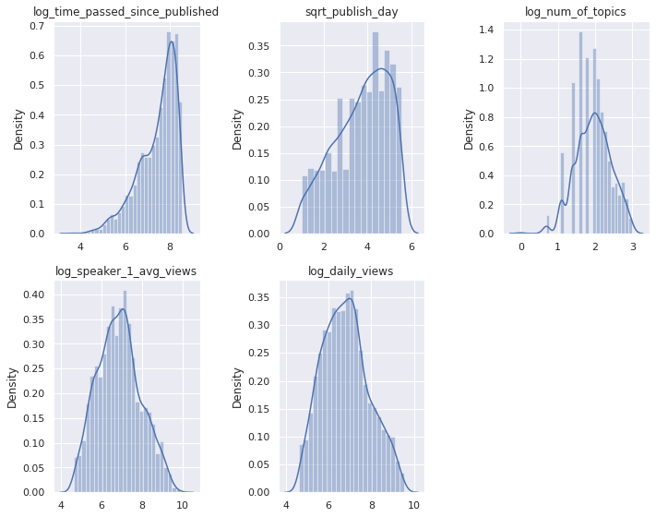
Transformation

Slide 26
Model preparation.
Removing null values from dataset
Introducing dummy variables for Categorical features
Defining dependent and independent features
Next we will standardize the features
Splitting the data into training and testing
Implementing Linear Regression Training Models
Model Accuracy on test data

Slide 27
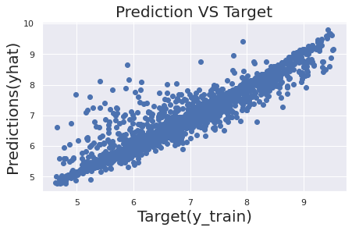
Model Accuracy on train data

Slide 28
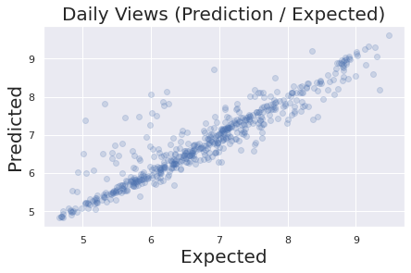
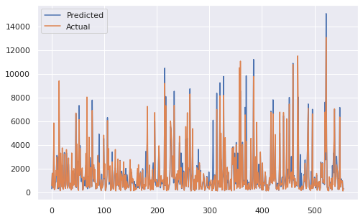
Model Accuracy on test data (Base LR Model)

Slide 29
Error metrics on Base LR Model
Values
R-Square- 0.83691
Adj.R-Square- 0.830500
MSE- 651492.850559
RMSE- 807.151070
MAE- 368.333887
MAPE- 0.344262

Slide 30
Hyperparameter Tuning through Grid Search
Grid Search combines a selection of hyperparameters established by the scientist and runs through all of them to evaluate the model’s performance. Its advantage is that it is a simple technique that will go through all the programmed combinations. The biggest disadvantage is that it traverses a specific region of the parameter space and cannot understand which movement or which region of the space is important to optimize the model.

Slide 31
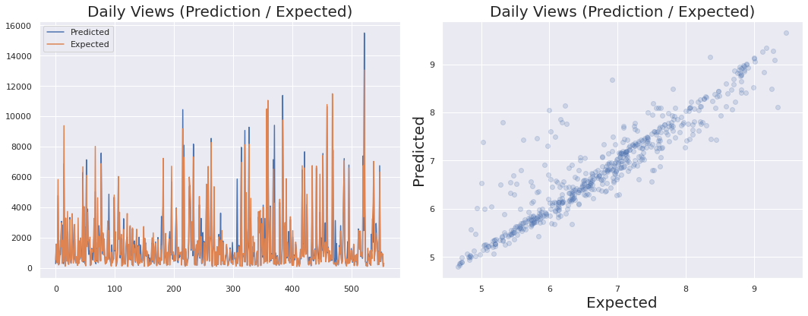
Model Accuracy on test data (Lasso Regression Model)
Running Grid Search Cross Validation
Running Grid Search Cross Validation

Slide 32

Ridge regression model
Running Grid Search Cross Validation

Slide 33

Elastic regression model
Running Grid Search Cross Validation

Slide 34
Observation
On comparing all the models our base linear regression model is still is performing better followed by Lasso, Ridge and ElasticNet Regression model on the basis of RMSE. But our model contains large number of outliers and the value of RMSE is affected by outliers therefore we will use MAE as our evaluation matrix according to which Lasso Regression has the best performance

Slide 35
Conclusion
We performed EDA, feature engineering, data cleaning, target encoding and one hot encoding of categorical columns, feature selection and then model building.
Then we checked our model for overfitting by comparing it with Lasso Regression model, Ridge Regression model, ElasticNet Regression model.
We found that our original base model was overfit and Lasso Regressor has the best accuracy.
In all of these models our mean errors is 13 %. That implies we have been able to correctly predict views 87 % of the time.
In all the features speaker_1_avg_views is most important this implies that speakers are directly impacting the views.

Slide 36
Future Work
Training our data on other models (XGB, Random Forest, etc)
More efficient Hyperparameter Tuning through techniques like Random Search

Slide 37
Q/A

